Slide 1
Call Event Analysis & Classification Classification
Purpose:
This presentation provides a trace-based explanation of representative voice call events observed during mobile network measurements.

Slide 2
Case Index / Navigation
1. Completed VoLTE Call
2. Low Coverage(LC LTE) - Dropped VoLTE Call
3. Low Coverage(LC LTE) - Failed VoLTE Call
4. Low Quality(LQ LTE) - Dropped VoLTE Call
5. Low Quality(LQ LTE) - Failed VoLTE Call
6. Completed Volte Call with SRVCC mode
7. Dropped Volte Call with SRVCC mode
8. Completed CS-GSM Call (A-B)
9. Completed CS-GSM Call (B-A)
10. Core Network (DRB_to Release)
11. Core Network(DL Release) to GSM
12. Core Network(No paging)
13. Core Network(SIP 503)
14. Fake end of file
15. Fake UE stuck(UL Disconnect)
General knowledge in Smart Analytics for measurement report values:
RSRP(dBm)=RSRP - 141
RSRQ(dB)=[(RSRQ/2)-20]
16. Fake UE stuck(CC Disconnect missing )
17. Fake No Sync
18. Fake UE stuck(no cm service request)
19. Fake UE stuck(No Response after Paging)

Slide 3
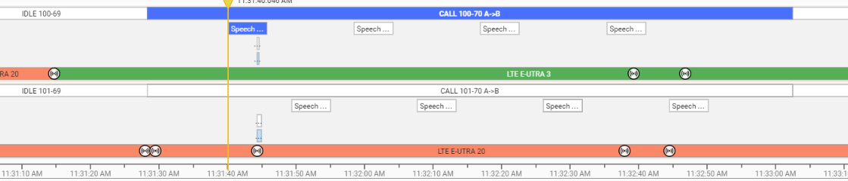
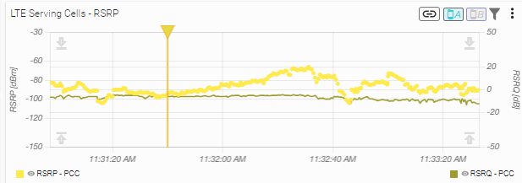
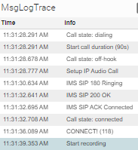
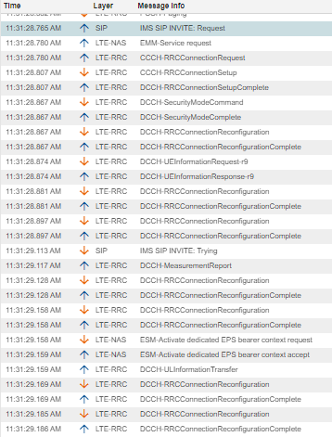
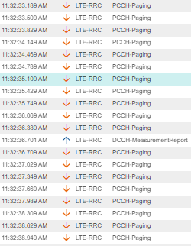
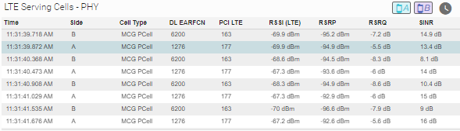
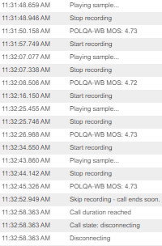
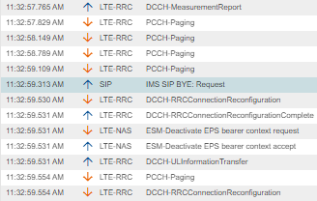

1. Completed VoLTE Call
Details :
The VoLTE call is successfully established and completed normally. SIP signaling follows the expected setup sequence (SIP INVITE → SIP 180 Ringing → SIP 200 OK → SIP ACK Connected) and the call enters connected state. Speech/POLQA samples are recorded with stable MOS values around 4.72–4.73. LTE radio conditions remain stable and acceptable during the call, with normal RSRP/RSRQ/SINR values and no indication of severe coverage degradation, RRC re-establishment, or abnormal release. The call ends normally after the configured duration is reached.
Back to Case Index

Slide 4
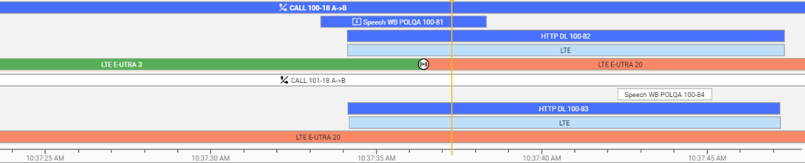
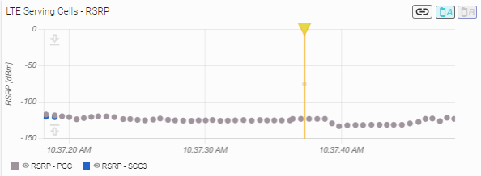
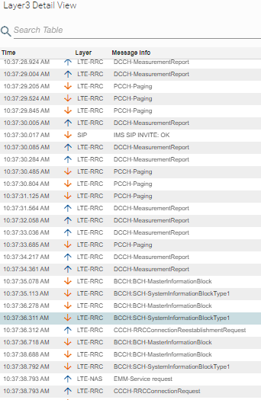
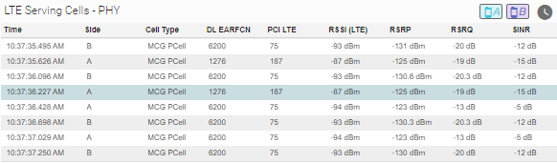
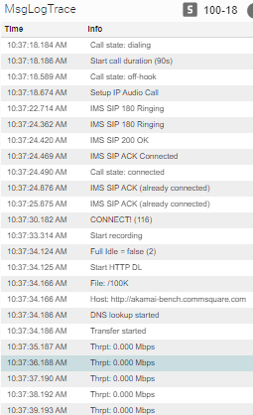
2. Low Coverage(LC LTE) - Dropped VoLTE Call
Details :
The VoLTE call is successfully established through SIP signaling (SIP 180 Ringing → SIP 200 OK → SIP ACK Connected) and reaches connected state. During the active call, LTE radio conditions are severely degraded, with serving cell RSRP around -123 to -131 dBm, poor RSRQ around -19 / -20 dB, and negative SINR values. Shortly before the drop, the trace shows RRC Connection Reestablishment Request, indicating that the UE attempts to recover the RRC connection after radio link degradation/failure. Since the call drops under very poor LTE radio conditions, this case is classified as Dropped VoLTE Call due to Low Coverage.
Back to Case Index

Slide 5
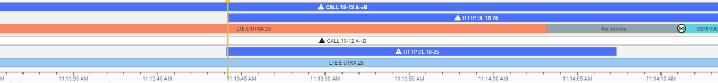
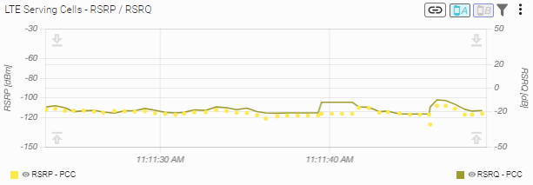
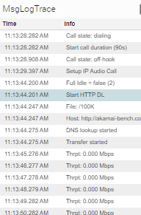
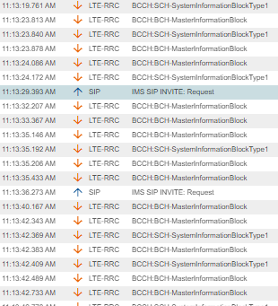
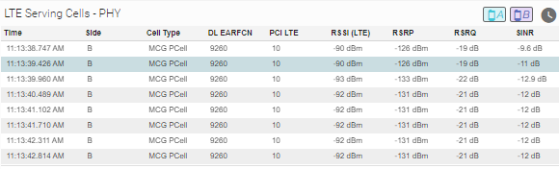
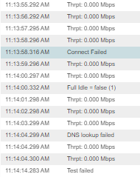
3. Low Coverage(LC LTE) - Failed VoLTE Call
Details :
The VoLTE call attempt is initiated, with IMS SIP INVITE Request observed, but the setup does not progress to a successful VoLTE connection, as no SIP 180 Ringing / SIP 200 OK / SIP ACK Connected sequence is observed. During the attempt, LTE radio conditions are severely degraded and repeated LTE broadcast/system information messages are observed, with serving cell RSRP around -126 to -133 dBm, poor RSRQ around -19 to -22 dB, and negative SINR around -10 to -13 dB . The session later ends with Connect Failed, while the call never reaches connected state. Therefore, this case is classified as Failed VoLTE Call due to Low LTE Coverage.
Back to Case Index

Slide 6
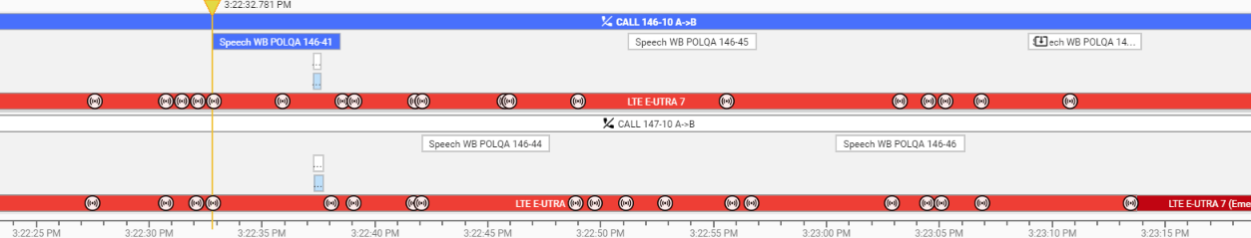
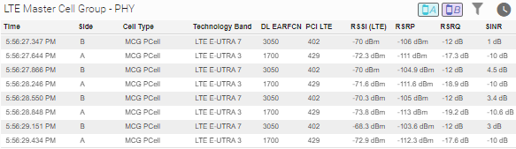
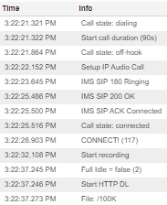
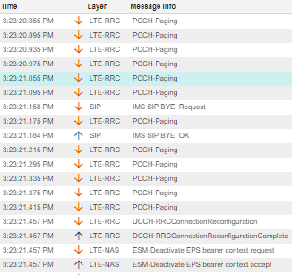
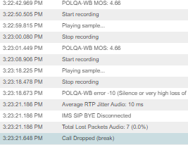
4. Low Quality(LQ LTE) - Dropped VoLTE Call
Details :
The VoLTE call is successfully established through IMS/SIP signaling (SIP 180 Ringing → SIP 200 OK → SIP ACK Connected) and reaches connected state. Initial POLQA samples show good voice quality (MOS ~4.66–4.68), however before the drop a POLQA-WB error -10 is reported, indicating silence or very high loss of speech signal. At the same period, LTE radio quality is degraded and repeated LTE broadcast/system information messages are observed, mainly due to poor RSRQ values around -17 dB, although RSRP is not extremely weak as in clear Low Coverage cases. After the audio quality failure, SIP BYE and bearer/session release signaling are observed, followed by Call Dropped (break). Therefore, this case is classified as Dropped VoLTE Call due to Low Voice Quality.
Back to Case Index

Slide 7
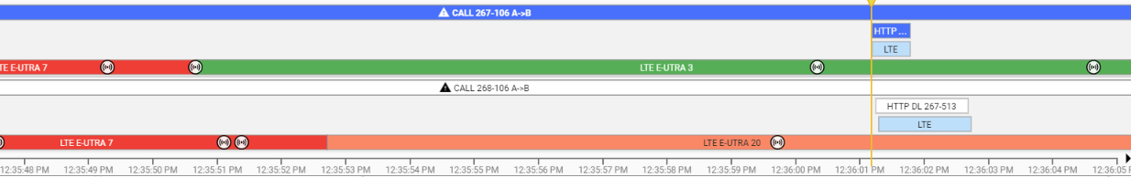
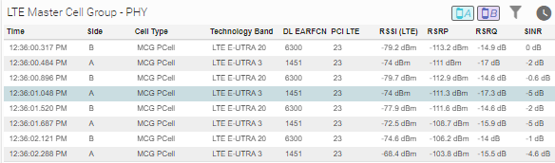
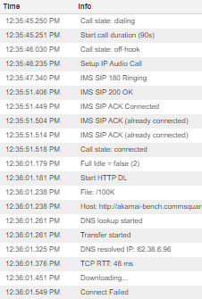
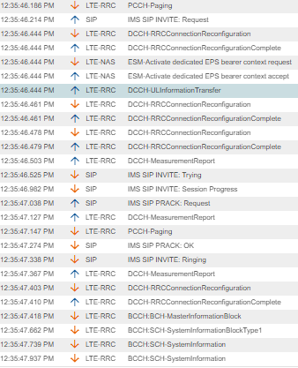
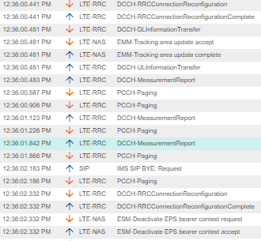
5. Low Quality(LQ LTE) - Failed VoLTE Call
Details :
The VoLTE call setup is completed successfully through IMS/SIP signaling (SIP 180 Ringing → SIP 200 OK → SIP ACK Connected) and the call reaches connected state. During the active session, LTE radio quality is degraded, mainly due to poor RSRQ values around -14 to -18 dB, while RSRP is not extremely weak as in clear Low Coverage cases. The trace also shows LTE RRC reconfigurations, measurement reports and tracking area update signaling , indicating radio/mobility activity under degraded LTE quality. A service failure is then observed with Connect Failed during the session. Since the main issue is poor LTE radio quality rather than very low RSRP, this case is classified as Low Quality LTE.
Back to Case Index

Slide 8
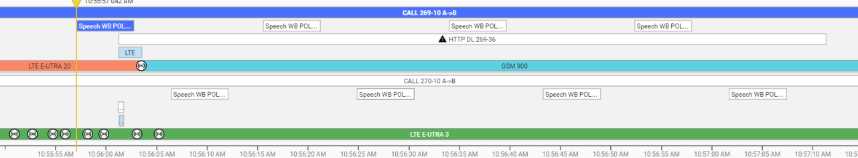
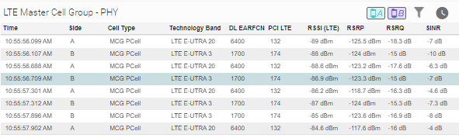
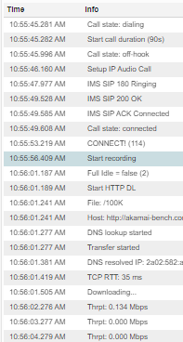
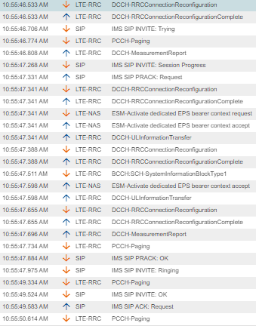
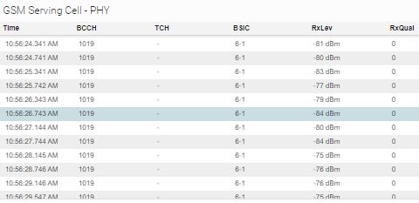
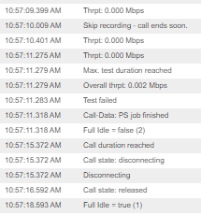
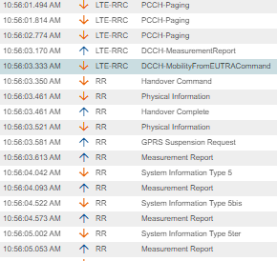
6. Completed Volte Call with SRVCC mode
Details :
The call is successfully established as a VoLTE session over LTE through IMS/SIP signaling (SIP 180 Ringing → SIP 200 OK → SIP ACK Connected) and reaches connected state. During the call, LTE radio conditions become degraded, with weak LTE RSRP and poor RSRQ/SINR values, so the network triggers SRVCC using Mobility From EUTRA Command. The call is then handed over from LTE to GSM, confirmed by RR Handover Command / Handover Complete and the appearance of GSM serving-cell measurements. After SRVCC, GSM radio conditions are acceptable, allowing the call to continue and end normally. Therefore, this case is classified as a Completed VoLTE Call with successful SRVCC continuity from LTE to GSM.
Back to Case Index

Slide 9
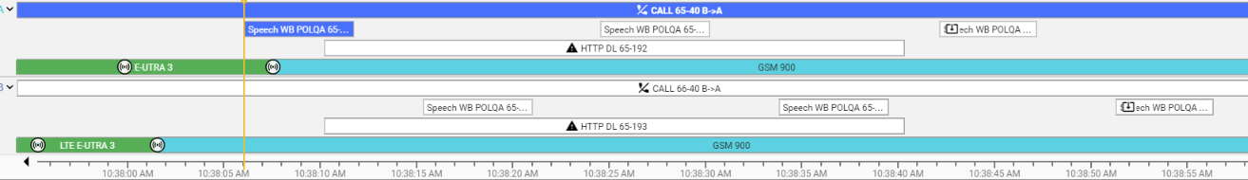
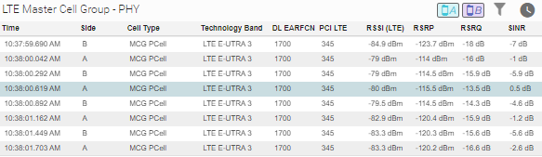
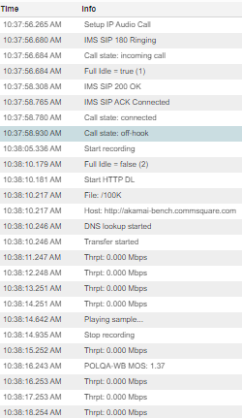
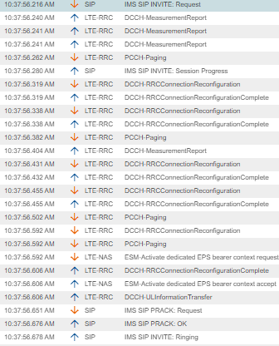
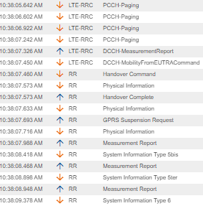
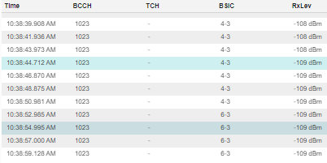
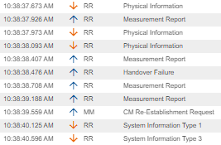
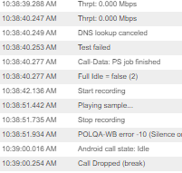
7. Dropped Volte Call with SRVCC mode
Details :
The call starts normally as VoLTE over LTE. Due to degraded LTE radio conditions, SRVCC is triggered by Mobility From EUTRA Command and the call is moved to GSM. However, the GSM target cell is also weak (Rx Lev ~ -108/-109 dBm). The following MM CM Re-Establishment Request shows an attempt to recover the ongoing call, but voice quality fails (POLQA-WB error -10) and the call finally drops.
Back to Case Index

Slide 10
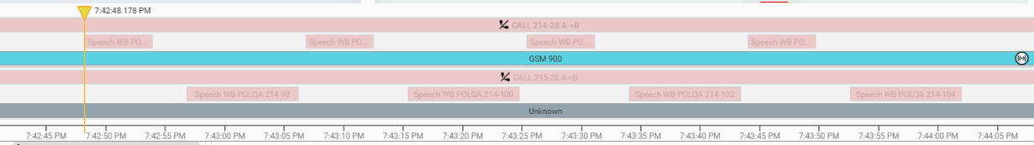
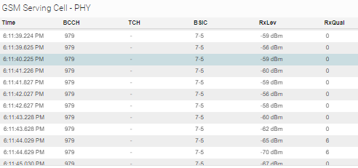
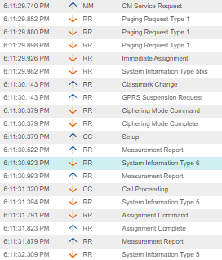
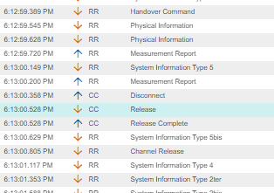
8. Completed CS-GSM Call (A-B)
Details :
The CS-GSM call is established and completed normally under good GSM radio conditions. The trace shows normal GSM call setup signalling, including CM Service Request, Immediate Assignment, Ciphering Mode Complete, CC Setup, Call Proceeding, and Assignment Complete. During the call, GSM radio levels remain good, with RxLev around -56 to -70 dBm and mostly good RxQual values. At the end of the call, the expected normal release sequence is observed: CC Disconnect → CC Release → CC Release Complete, followed by Channel Release
Back to Case Index

Slide 11
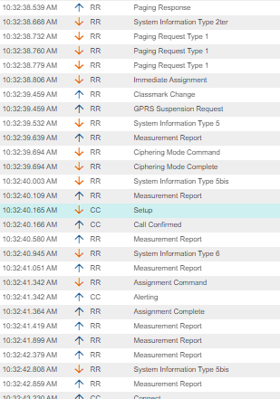
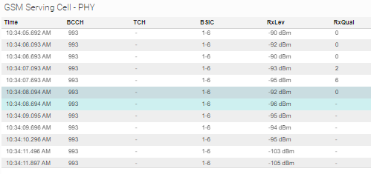

9. Completed CS-GSM Call (B-A)
Details :
The B → A CS-GSM call follows the normal terminating call flow, with paging/call setup signaling , Immediate Assignment, Ciphering Mode Complete, CC Setup, Call Confirmed, Alerting, and Assignment Complete. GSM radio conditions are usable (Rx Lev ~ -90 to -105 dBm, mostly acceptable Rx Qual), and normal CC Disconnect / CC Release is observed at the end.
Back to Case Index

Slide 12




10. Core Network (DRB to Release)
Details :
The VoLTE call is already established and radio conditions are stable, with acceptable RSRP/RSRQ/SINR values and no indication of low coverage, HO failure, or radio link degradation. During the active session, the network sends RRC Connection Reconfiguration including drb_To Release List / DRB Identity 3, instructing the UE to release the dedicated radio bearer. The UE responds with RRC Connection Reconfiguration Complete, confirming that the reconfiguration was applied. After the DRB release, the call state changes to off-hook and then the call is dropped.
Since RSRP/RSRQ/SINR are acceptable and there is no HO failure or radio degradation, this case is classified as Core Network / DRB Release, not low coverage.
Back to Case Index

Slide 13




11. Core Network(DL Release) to GSM
Details :
The GSM call is established normally and radio conditions remain acceptable (Rx Lev ~ -75 to -88 dBm, mostly good Rx Qual). No radio failure or weak coverage indication is observed. During the release phase, the trace shows downlink CC Release from the network side, followed by CC Release Complete from the UE/MS and Channel Release. Since the release is initiated by the network under acceptable GSM radio conditions, the case is classified as Core / Network Initiated DL Release
Back to Case Index

Slide 14


12. Core Network(No paging)
Details :
For this B → A GSM call, the terminating side should receive a network Paging Response before the incoming call setup. However, no Paging Request is observed in the trace; only normal GSM broadcast/system information messages are present. GSM radio conditions are stable and acceptable (Rx Lev around -87 dBm, good Rx Qual), so there is no indication of low coverage or radio failure
Back to Case Index

Slide 15




13. Core Network(SIP 503)
Details :
The LTE radio conditions are acceptable, with normal RSRP/RSRQ values and no indication of radio failure. The UE sends IMS SIP INVITE Request, but the call setup fails with IMS SIP INVITE Error 503, meaning the IMS/network side is temporarily unable to handle the request. No successful VoLTE setup sequence follows (no SIP 180 Ringing / 200 OK / ACK Connected). After the SIP failure, the network sends ESM Deactivate EPS Bearer Context Request and the UE replies with Deactivate EPS Bearer Context Accept, releasing the bearer.
Back to Case Index

Slide 16




14. Fake end of file
Details :
The event occurs on the last call of the measurement file, while the next file starts later at 15:55:21. The system trace shows Test aborted / Job stopped / User stop / Closing current database, indicating that the measurement was stopped by the user/tool. Radio conditions are mostly acceptable and no network/radio failure is observed.
Back to Case Index

Slide 17




15. Fake UE stuck(UL Disconnect)
Details :
The call/session is established normally on GSM and the radio conditions remain good, with Rx Lev around -69 to -83 dBm and mostly good Rx Qual values. No weak coverage or radio failure indication is observed. Later, the trace shows an uplink CC Disconnect message sent by the UE/MS, followed by normal Release and Release Complete signaling
Back to Case Index

Slide 18



16. Fake UE stuck(CC Disconnect missing )
Details :
The GSM call has good radio conditions (Rx Lev ~ -79/-82 dBm, Rx Qual 0) and speech/POLQA samples are recorded until the end. After the last MOS, normal CC Release / Release Complete signaling is observed, with no radio failure indication. Since the expected uplink CC Disconnect is missing, the system marks the call as dropped/UE stuck, although the behavior matches a normally completed call.
Back to Case Index

Slide 19





17. Fake No Sync
Details :
The CS-GSM call is established and released normally, while GSM radio conditions remain good (Rx Lev ~ -75 to -82 dBm, good Rx Qual). The trace shows normal call signaling and normal release procedure (CC Disconnect → CC Release → CC Release Complete / Channel Release). However, before the call fully ends, the tool reports No Sync found / No synchronization. Since there is no weak coverage, no bad Rx Qual, and no abnormal radio failure indication, this is classified as Fake No Sync
Back to Case Index

Slide 20



18. Fake UE stuck(no cm service request)
Details :
For an A → B CS-GSM call, the originating UE should initiate the call setup by sending UL MM CM Service Request. In this trace, no CM Service Request is observed; only packet/GPRS/RR signaling is present and the call later ends with Connect Failed. GSM radio conditions are good (Rx Lev ~ -61 to -66 dBm), with no low coverage or radio failure indication.
Back to Case Index

